Slide 1
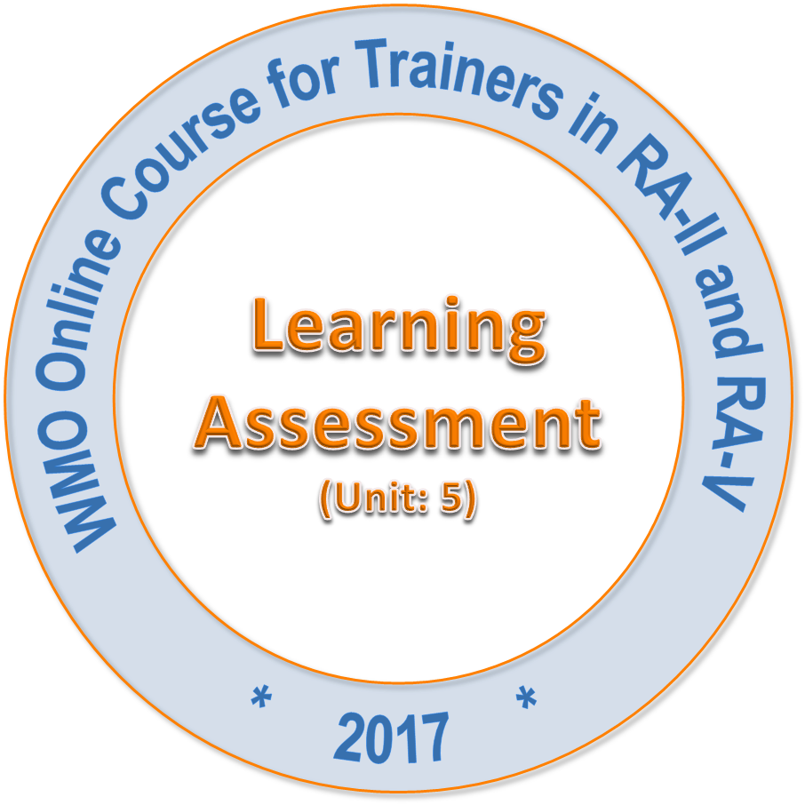
Open Badges for WMO Competency Training Achievement
Patrick Parrish (WMO) Eduard Podgaiskii (RSHU)
Technical Task Team for WMO Global Campus Feasibility Study

Slide 2
What are Open Badges?
Open badges are “micro-credentials” that demonstrate accomplishment, developed skills, community-recognized qualities, or interests.
Badges are combinable -- multiple badges from different issuers to form their collection -- a complete story of achievements.
A free and open technical standard that can be used by any organization or society institutions.
Open Badges are motivating!
Badges are transferable--they can be accessed in many contexts and preserved into the future, both online and offline.
Badges can be used as awards for formal, non-formal and informal learning.
Can be centrally monitored and administrated, yet allow issuance by any qualified institution.

Slide 3
Why not just certificates/diplomas?
Paper certificates can be lost or destroyed, digital badges are forever.
Diplomas are important, but they do not show what is behind the large accomplishment!
Badges can be issued by many qualified issuers.
Badges can be used to recognise Prior Learning.
Badges can provide feedback, incremental reward and motivation.
Badges can recognise extra-curricular activities and community memberships (like CALMet!)
Badges can define learning pathways and progress on along a path more clearly.
Badges can define levels and kinds of competence
Badges could be used as demonstration of development of WMO Competencies

Slide 4
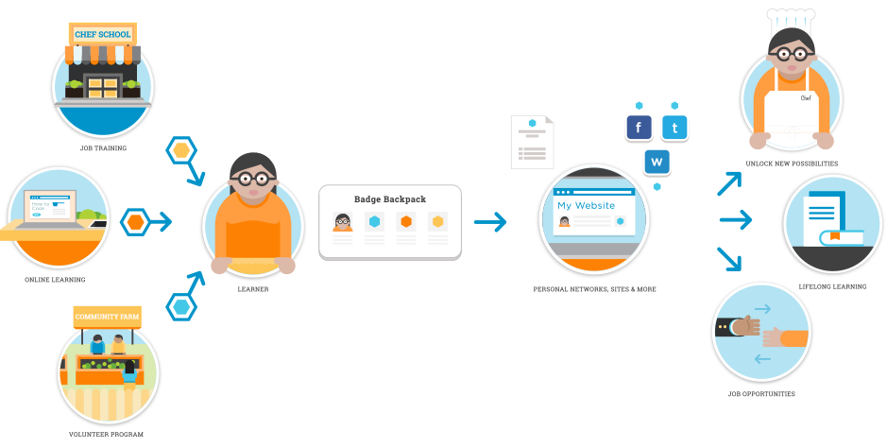
How Open Badges work (in a nutshell)
Open Badges stored in “Backpacks,” displayed in personal and social media sites
Open Badges used for job opportunities and personal recognition
Many sources of Open Badges
Mozilla Foundation, 2012-13

Slide 5
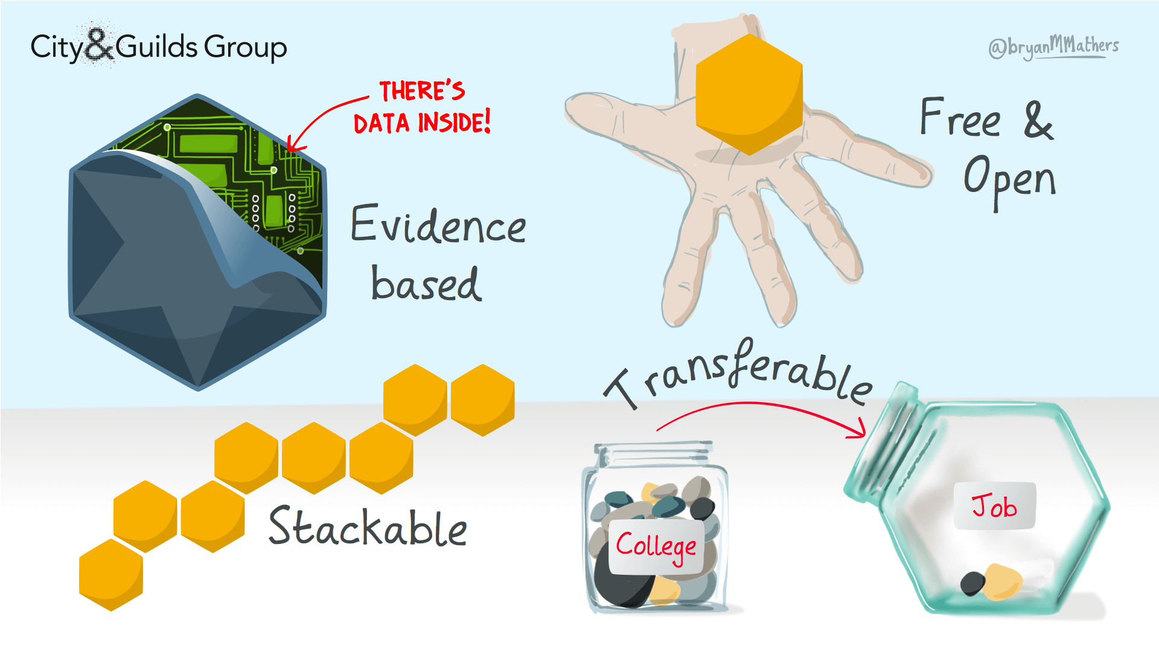
Properties of Open Badges
Properties of Open Badges by @bryanMMathers is licenced under CC-BY-ND

Slide 6
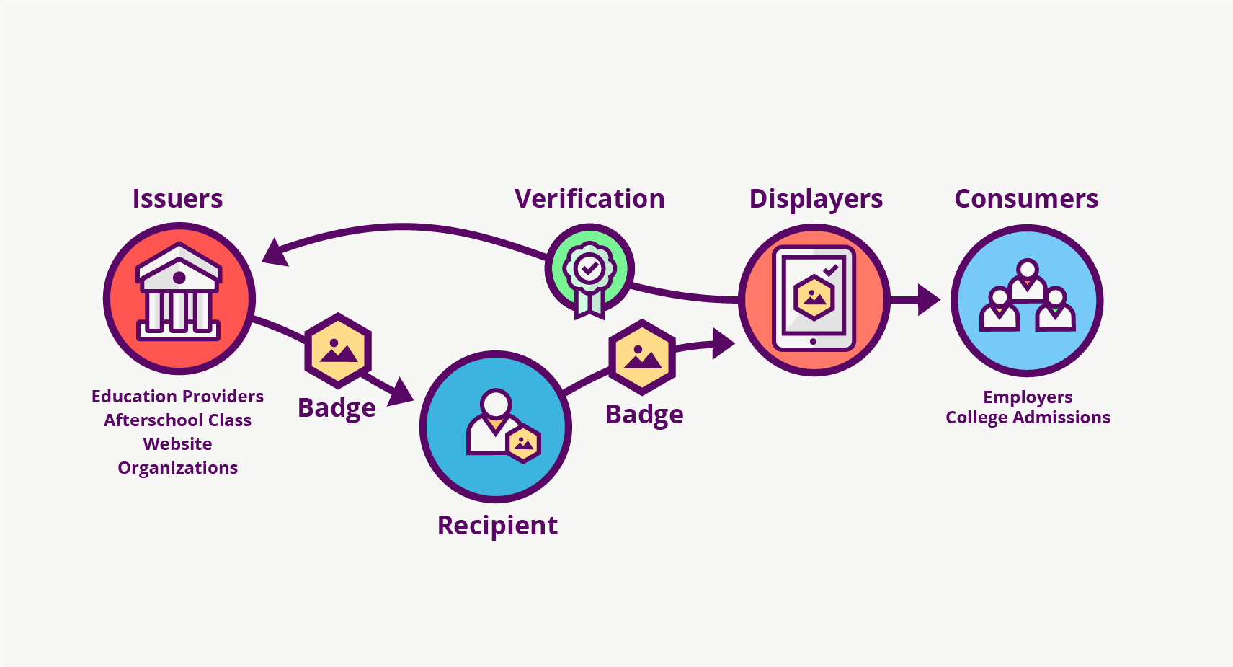
The Open Badge Ecosystem
The Open Badges Ecosystem (by Erik Knutson, Concentric Sky, licensed CC-BY)

Slide 7
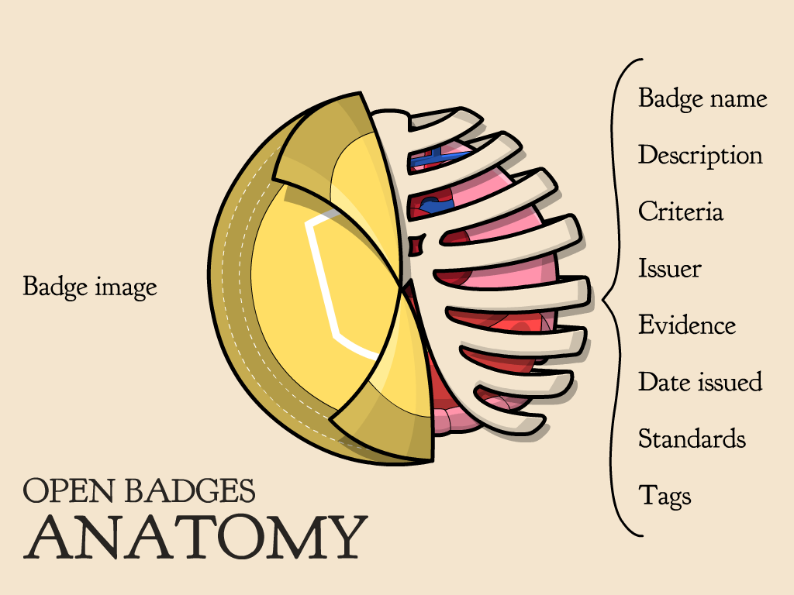


Slide 8
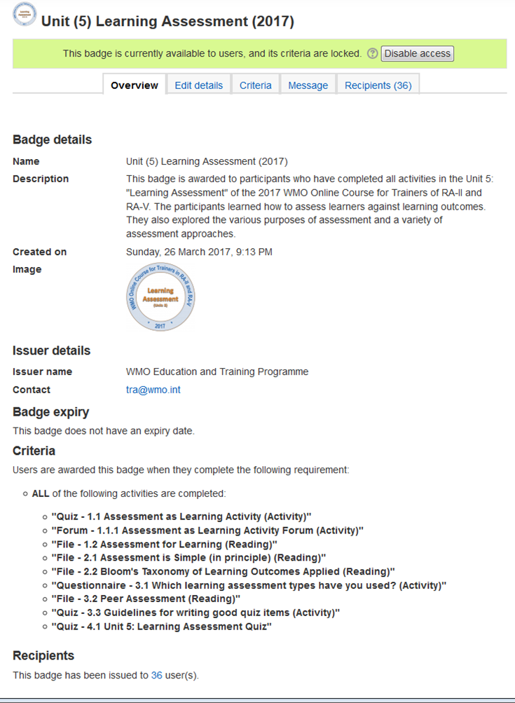
Badge set up in Moodle
Badge name and description
Badge image (created elsewhere)
Issuer details and contact
Expiry, if relevant
Criteria for receiving the badge
# of recipients so far

Slide 9
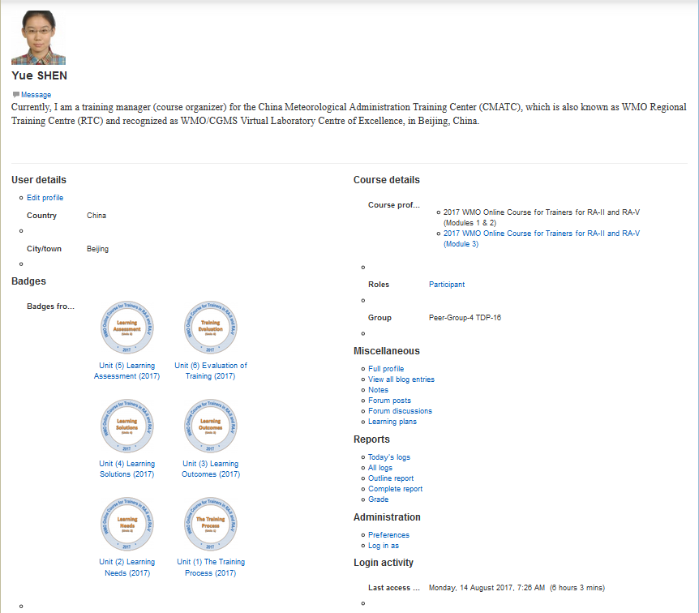
Badge profile in Moodle
Badges earned

Slide 10
Case Study: DisasterReady.org
DisasterReady.org . Collaboration in 190 countries . 60,000 humanitarian members
DisasterReady.org offers aid workers and volunteers professional development opportunities by accessing online learning anywhere and anytime at no cost. Their extensive, open online learning library consists of more than 600 learning resources and covers topics such as Humanitarianism, Program/Operations, Protection, Staff Welfare, Management and Leadership, Staff Safety & Security as well as Soft Skills.
Before Open Badges came along, the best verification was to print the transcript from the DisasterReady learning portal. With Open Badges, learners can display and publish their professional development achievements, which may help with future career and education opportunities.
To help learners build competencies in a specific area, the team bundled learning resources into learning pathways (learning packs) on essential topics like security in the field or humanitarian principles. The challenge was getting learners to complete all the training in the learning pathway. Open Badges increased engagement and incentive to complete training.

Slide 11
Case Study: Cities of Learning
www.lrng.org . 11 member US cities . Links formal and informal learning
LRNG works with cities and organizations to connect learning experiences to career opportunities, ensuring that all young people, especially those from underserved communities, have inspiration and guidance to prepare them for life and work in the modern economy.
Developing skills, mindsets, and habits that youth can take to college and jobs, “Playlists,” or learning paths, equip youth with tangible skills and understandings that they can apply in academic and career settings.
The LRNG platform enables access to both local and national opportunities from computers, smartphones, or tablets, providing links to mentors and peers, building new skills and habits whenever they want.
Every time a participant completes a Playlist, they receive a digital badge that marks their skill and knowledge. These badges can unlock real world opportunities that include academic credit, internships, and jobs.

Slide 12
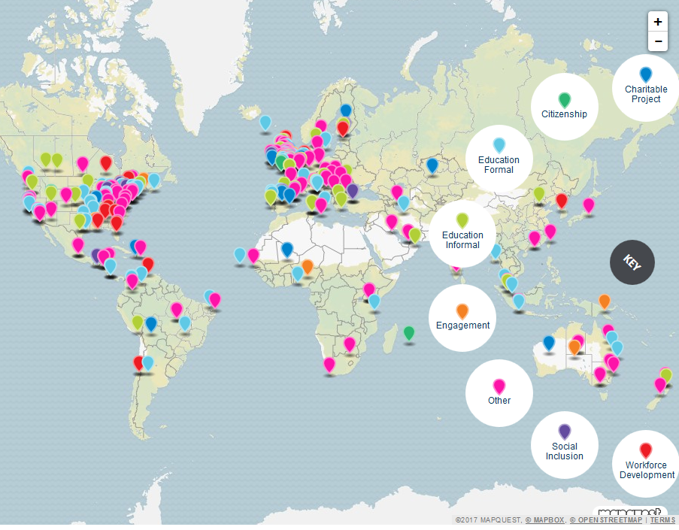
Where are Open Badges used?
More than 900,000 badges have been issued to hundreds of thousands of learners.
Universities
NGOs
International Organizations
Private Companies
National Qualifications
https://openbadges.org

Slide 13


Open Badge Factory
Open Badge Passport
Open Badge Factory is an internet platform that offers tools for creating, issuing and managing Open Badges.
Open Badge Passport is a FREE web tool for saving Open Badges as they are earned.
Badges can be received, saved, and organized in the system.
Badges can also be shared through social media such as LinkedIn, Twitter, and Facebook.
Badges can be incorporated into CVs and resumés.
Roles include Administrator, Creator, and Issuer, each with specific tools.
Statistics and reports are included.
Recipients, or badge earners, do not use Open Badge Factory, but can have their badges sent from here.
Badges can be issued manually, requested, or automatically granted when milestones are reached.
Plugins available for Mahara, Moodle, Totara, Wordpress, Blackboard, Canvas

Slide 14
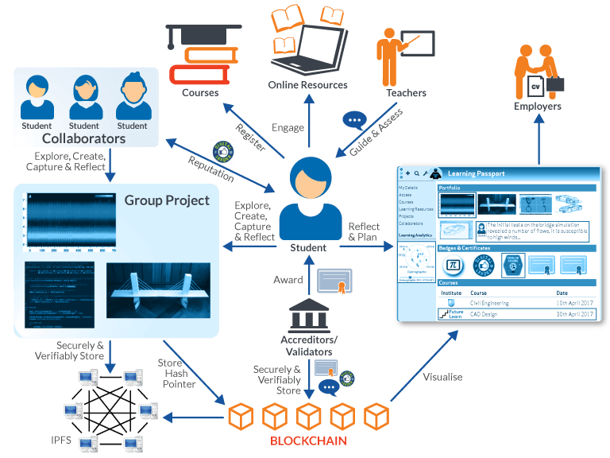
Open badges are assets =>
can be managed with blockchain
http://blockchain.open.ac.uk

Slide 15
Badges for WMO competencies might require standard documentation by the issuing institutions, indicating quality control
Potential Uses
Practically all learning can be documented via open badges (not just online learning)
Learning paths--smaller achievements might be indicated by smaller badges, but also lead to larger accumulative recognition (certificates or bigger badges)
Badges given to organizations issuing X number of badges for a community
Badges could be issued for successful competency assessment outcomes
Badges issued to institutions, like RTCs, after WMO external review?
Award criteria, managed by the standard documentation procedures regulated by IMS, can help ensure consistent course quality among issuers
Competency badges might indicate levels (Basic, Advanced, etc.), related to something objective, like number of competencies in a framework addressed by a training event

Slide 16
Some challenges for WMO to use Open Badges?
(help us overcome them)
Gaining mutual recognition of badges by organizations involved
How to ensure that the Open Badges issued are deemed worthy of recognition, that there is substance behind them
Establishing common quality standards behind the badges through the entire system
WMO is not a certification body of training or education, but a creator of standardized processes
How to ensure rigor of the badge creation (standard, regulated documentation procedures)
Overcoming the tradition of a signed, paper certificate

